Slide 1
Creating a Basic Form Module
Notes:
Schedule: Timing Topic
40 minutes Lecture
30 minutes Practice Session 1
40 minutes Lecture
30 minutes Practice Session 2
140 minutes Total
Instructor Note
This lesson is divided into two sections. There is a practice midway through the lesson, and another practice at the end of the lesson.

Slide 2
Objectives
After completing this lesson, you should be able to do the following:
  Create a form module
  Create a data block
  Modify a data block
  Modify the layout
  Save and compile a form module
  Identify Forms file formats and their characteristics
  Explain how to deploy a form module
  Create data blocks with relationships
  Run a master-detail form module
Notes:
Introduction
Overview
Oracle Forms Developer applications usually consist of one or more form modules. Each form module consists of data blocks that are built using table specifications from the database. This lesson shows you how to create a basic form module and its data blocks.

Slide 3
Creating a New Form Module
Create an empty module
Create data blocks and items
Apply standards
Fine-tune layout
Set object properties
Add code
Test form module
Notes:
Creating a New Form Module
This lesson covers the basic process for creating a new form module and data blocks within it.
How to Create a New Form Module

Slide 4
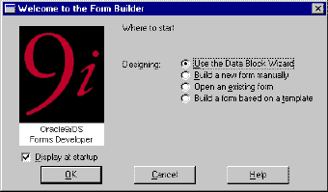
Creating a New Form Module
Choose one of the following methods:
  Use wizards:
    Data Block
    Wizard
    Layout Wizard
  Build module
  manually
  Use template form
Notes:
Creating a New Form Module
There are several ways to create a new form module.
Invoke the Forms Builder component. This takes you to the Forms Builder Welcome page, unless you have changed the Preferences to not display it. Now do one of the following:
Select the “Use the Data Block Wizard” option, then follow the required data block creation steps. Then follow the Layout Wizard steps.
Select the “Build a new form manually” option. This takes you into the Forms Builder Object Navigator (automatically creating an empty form module).
Select the “Build a form based on a template” option and use a template form.
If you are already in the Forms Builder component, you can create a new form module by doing one of the following:
Double-click the Forms node in the Object Navigator (only when no other form modules are available).
Select File > New > Form.
Select the Object Navigator node for Forms, and then click the Create icon.

Slide 5
Notes:
Creating a New Form Module (continued)
Changing the Form Module Name
When you first build a form module, Forms Builder assigns the name MODULEXX to the new form module, where XX is the next number available for module names. This name is displayed in the Object Navigator and in the Property Palette. You should change the default name to a meaningful name in either of the following places:
In the Object Navigator:
Click the form module name.
Change the default name as desired and press [Enter].
In the Property Palette (shown on the next page)
Note: Follow Oracle naming rules. Do not give two objects of the same type the same name. The name cannot include Oracle or Forms Builder reserved words.
Instructor Note
Demonstration
Create a new, empty form module and change its name to DEPT_EMP.

Slide 6
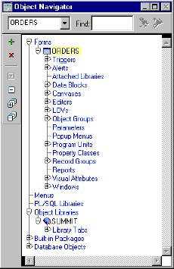
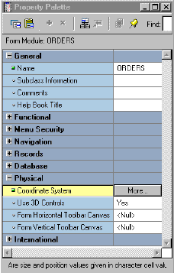
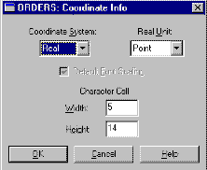
Form Module Properties
Name
property
Coordinate
System
property
Notes:
Setting Form Module Properties
Each form module consists of several objects. Objects within a form, and the form module itself, have properties that define their behavior. You can see the properties of an object and their values in its Property Palette.
To open the Property Palette of an object, do one of the following:
Double-click the object’s icon in the Object Navigator.
Select the object in the Object Navigator and select Tools > Property Palette.
To obtain online help for any of the properties, click the property and use the Help key, [F1], to bring up a description of that property.
Define the properties of the form module when you first create it. The properties affect the general behavior of the form and the objects within it. Properties for a form module include the following:

Slide 7
Notes:
Setting Form Module Properties (continued)
Choosing a Unit for the Coordinate System
When you click More in the Property Palette window with the Coordinate System property selected, the Coordinate Info window opens.
The Coordinate System unit for a form can be one of the following:
Real:
Unit can be pixel, centimeter, inch, point, or decipoint.
Real units are suitable for GUI applications and enable flexibility and fine alignment when adjusting object positions and sizes.
Character: Units are character cells (default size taken from the default font settings).
The default unit is point (Real). This means that object positions and sizes within the form are measured by this unit. Points provide fine alignment and consistency across different platforms and video devices.
Instructor Note
Open the Property Palette of the new form module. Concentrate only on the Name and Coordinate System properties. Point out that other properties will be discussed in later lessons. Open the Coordinate Info window and explain the implications of choosing the units. (72 points = 1 inch). Points allow for flexibility when designing cross platform applications.

Slide 8

Creating a New Data Block
  Use Forms Builder Wizards:
    Data Block Wizard: Create a data block with associated data source quickly and easily
    Layout Wizard: Lay out data block contents for visual presentation
  Create manually
Notes:
Creating a New Data Block
A form module consists of one or more data blocks and control blocks. Now that you know how to create a new form module, you need to create new data blocks within it.
Block creation involves creating the data block and then laying out its contents for visual presentation. You can create a data block manually or by using the Forms Builder wizards. In this lesson you learn how to create a new data block based on a database table, using the Data Block Wizard and the Layout Wizard.
Note: Recall that a data block can be based on a table or view, a stored procedure, a FROM clause query, or a transactional trigger. In this course, you use database tables as the source.

Slide 9
Creating a New Data Block
Launch Data
Block Wizard
Reentrant mode
Enter data
source
Launch Layout
Wizard
Reentrant mode
New Data Block
Lay out data
block contents
Notes:
Creating a New Data Block (continued)
Data Block Wizard
The Data Block Wizard enables you to create (or modify) data blocks quickly and easily for use in your application. The wizard can automatically generate code to enforce integrity constraints in the database.
Layout Wizard
Although the Data Block Wizard allows you to create a new data block easily with its associated data sources, it does not deal with the visual presentation of objects included in the data block. Once you create the data block, you need to lay out its contents for user interaction. To accomplish this task quickly and easily, use the Layout Wizard.
Note: The wizards are not the only way to perform a task such as building a data block, but they are usually the simplest. You can build a block manually instead of using the wizards.

Slide 10


Navigating the Wizards
Available only
in reentrant mode
Exit
without saving
Save
without exiting
Next
screen
Invoke
online help
Previous
screen
Save
and exit
Tabbed Interface:
Available only in reentrant mode
Notes:
Navigating the Wizards
The Data Block Wizard and the Layout Wizard provide several buttons to help you navigate.
If you click Next or Back before entering all necessary information for a particular wizard page, the wizard prevents you from navigating to another page. Similarly, if you have not entered all necessary information into the wizard when you click Apply or Finish, the wizard automatically takes you to the page where you can finish entering the required information.
In reentrant mode, which you learn about later in this lesson, the wizards have a tabbed interface that enables you to quickly navigate to the section you want to modify.

Slide 11

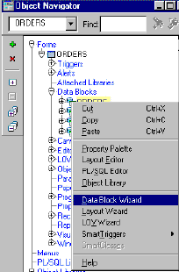
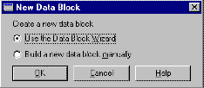

Launching the Data
Block Wizard
In Forms Builder, do one of the following:
  Select Tools > Data Block Wizard.
  Right-click and select Data Block Wizard.
  Select the Data Blocks node
  and click Create icon; select
  Use the Data Block Wizard option.
  Use the Data Block Wizard button on the toolbar in the Layout Editor.
Notes:
Launching the Data Block Wizard
To launch the Data Block Wizard, perform one of the following:
In the Forms Builder, do one of the following:
Select Tools > Data Block Wizard from the Forms Builder default menu system.
Right-click and select the Data Block Wizard option.
In the Object Navigator, select the Data Blocks node, then click the Create icon. In the New Data Block dialog box, select the Use the Data Block Wizard option.
In the Layout Editor, click Data Block Wizard on the toolbar.
If you are not already in Forms Builder, launch Forms Builder and select the Use the Data Block Wizard option in the Forms Builder Welcome page.
Instructor Note
Demonstration
Create a new data block by using the Forms Builder wizards. Base the data block on the DEPARTMENTS table. Use the Form (not tabular) layout.

Slide 12
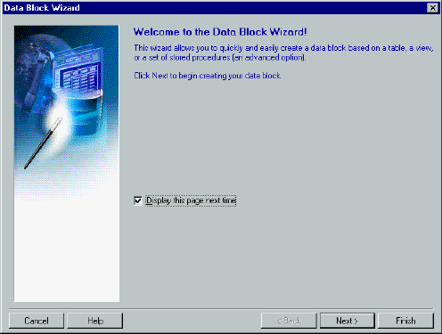
Data Block Wizard: Type Page
Notes:
Creating a New Data Block with the Data Block Wizard
Use the Data Block Wizard to create a new data block with its associated data sources. The Data Block Wizard consists of several pages. To create a new data block, you must interact with each page.
Welcome Page
Click Next to continue.
Type Page
Choose between one of two data source types:
Table or View
Stored Procedure
Select the Table or View (default) option.

Slide 13
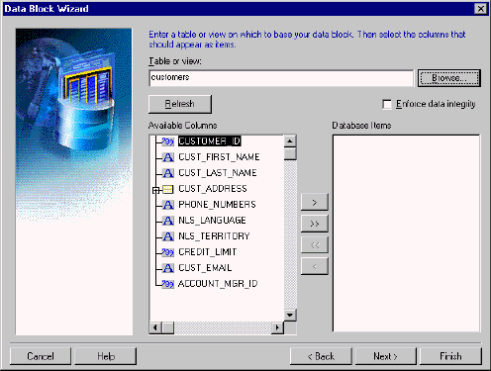
Data Block Wizard: Table Page
Notes:
Creating a New Data Block with the Data Block Wizard (continued)
Table Page
1. Enter the table or view name for the data source name, or click Browse and select a name from a dialog box.
2. Click Refresh to display a list of columns in the selected table or view. If you are not connected to the database, the Connect box is displayed.
3. Select the columns you want to include in the data block. (Use [Control]- click to select more than one column.)
4. Click the double right arrow or the double left arrow to include or exclude all columns, or click the right arrow or the left arrow to include or exclude selected columns only. You can also drag selected columns from one list to another.
5. Select the Enforce Data Integrity check box if you want the wizard to enforce the database integrity constraints.
Note: If there is at least one other existing block in the current module, the next page that displays is the Master-Detail page, where you can associate the new data block with other master data blocks. This page is discussed later in the lesson.

Slide 14
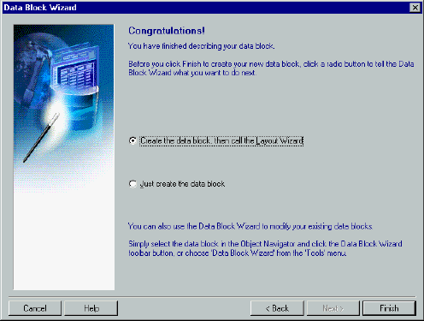
Data Block Wizard: Finish Page
Data Block Wizard: Finish Page
Notes:
Creating a New Data Block with the Data Block Wizard (continued)
Finish Page
Select the “Create the data block, then call the Layout Wizard” option. Select Finish to create the new data block and immediately invoke the Layout Wizard.
Note: You have the option of exiting the Data Block Wizard at this stage, without immediately invoking the Layout Wizard. If you do so, you can either lay out the data block manually or invoke the Layout Wizard at a later time to lay out the items of a data block. To invoke the Layout Wizard at a later time, select the data block in the Object Navigator, and choose Tools > Layout Wizard.
Instructor Note
You can also select Oracle9i objects as object data sources in the Layout Wizard. Appendix E of this course describes the basics of Oracle9i objects.

Slide 15
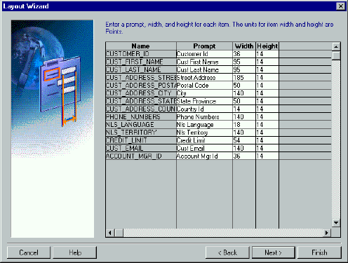
Layout Wizard: Items Page
Notes:
Laying Out a New Data Block with the Layout Wizard
Use the Layout Wizard to lay out the data block items for visual presentation quickly and easily. The Layout Wizard consists of several pages. You must interact with each page.
Welcome Page
Click Next to continue.
Canvas Page
1. Select New Canvas from the Canvas pop-up list to get a new canvas on which to display the data block items.
2. Select Content as the canvas type in the Type pop-up list.
Data Block Page
1. Select the items that you want to display in the data block frame. (Use
[Ctrl]-click to select more than one column.)
2. Click the double right arrow or double left arrow to include or exclude all items, or click the right arrow or the left arrow to include or exclude selected items only. You can also drag and drop selected items from one list to another.
Note: To lay out the items in a particular sequence, drag items into that sequence.

Slide 16
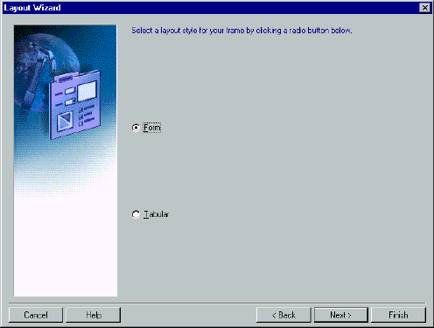
Layout Wizard: Style Page
Notes:
Laying Out a New Data Block with the Layout Wizard (continued)
Data Block Page (continued)
3. You can use the Item Type pop-up list to select a type for each item. The default type is Text for each item.
Note: An item type can also be changed later to something else, such as pop-up list or radio group.
Items Page
Specify the prompt text and the display width and height for each display item for the data block.
Style Page
Select a layout style for your frame. Your options are:
Form (usually used to create single-record data blocks)
Tabular (usually used to create multirecord data blocks)

Slide 17
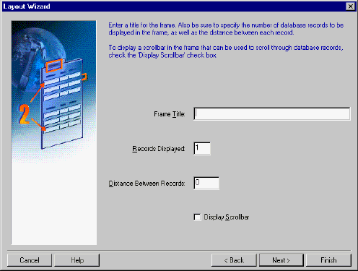
Layout Wizard: Rows Page
Notes:
Laying Out a New Data Block with the Layout Wizard (continued)
Rows Page
1. Enter a title in the Frame Title field.
2. Enter the number of records that you want to display at run time in the Records Displayed field.
3. Enter the physical distance (in the coordinate system unit of the form) between records if you are displaying more than one record at a time.
4. You can select the Display Scrollbar check box to display a scroll bar next to the frame (common for multirecord data blocks).
Finish Page
Click Finish to create a new frame and lay out the selected items for the new data block. The Layout Wizard steps are complete.
Note: Once you complete the Layout Wizard steps, you can view the layout in the Layout Editor, where you can customize or modify the layout if necessary.

Slide 18
Data Block Functionality
Once you create a data block with the wizards, Forms Builder automatically creates:
  A form module with database functionality including query, insert, update, delete
  A frame object
  Items in the data block
  A prompt for each item
  Triggers needed to enforce database constraints if “Enforce data integrity” is checked
Notes:
Data Block Functionality
Once you create a new data block by using the wizards, Forms Builder automatically creates the following objects for you:
A new form module with a default menu (Basic database functionality such as querying, inserting, updating, and deleting is automatically available on the items in the base table block when you run the new form.)
The new data block is created with default property values. These values can be modified to change the behavior of the form
A frame object to arrange the items within the new data block
An item for each database table column included in the data block (Each item is assigned default property values to match the underlying column specifications.)
A prompt for each item in the data block (The default prompt is the name of the column.)
In addition, Forms Builder may create triggers to validate user input if you check “Enforce data integrity” in the table page of the Data Block Wizard.

Slide 19

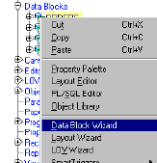
Modifying the Data Block
  Reentrant Data Block Wizard:
    1. Select frame or object in Layout Editor,
    or data block or frame in
    Object Navigator
    2. Select Tools > Data Block
    Wizard OR
    Right-click and select Data
    Block Wizard OR
    Click Data Block Wizard
  Object Navigator:
    Create or delete items
    Change item properties
  Block Property Palette: Change property values
Notes:
Modifying the Data Block
Once you create a data block, you may want to customize or modify it by performing one of the following:
Reenter the Data Block Wizard, and use it to make the changes.
Make manual changes, such as adding or deleting items, in Object Navigator.
Change the property values of the block by using the Property Palette.
Invoking the Data Block Wizard in Reentrant Mode
A very powerful feature of the Data Block Wizard is its ability to operate in reentrant mode. Use the reentrant mode to modify the data block, even if the block was not originally created with the Data Block Wizard.
To invoke the Data Block Wizard in reentrant mode:
1. Select the frame or a component of the block in either the Object Navigator or the Layout Editor.
2. Invoke the Data Block Wizard by performing one of the following:
Select Tools > Data Block Wizard from the menu
Right-click and select Data Block Wizard from the pop-up menu
Click Data Block Wizard

Slide 20

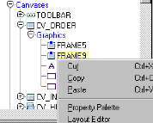
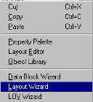

Modifying the Layout
  Reentrant Layout Wizard:
    Select frame in Object
    Navigator or Layout Editor
    Select Tools > Layout Wizard
    OR
    Right-click and select Layout
    Wizard OR
    Click Layout Wizard
  Layout Editor:
    Select Tools > Layout Editor
    Make changes manually
  Frame Property Palette: Change property values
Notes:
Modifying the Layout
You may want to customize or modify the layout of the data block items on the canvas. You can do this by doing one of the following:
Reenter the Layout Wizard (see the next section), and use it to make the changes.
Select Tools > Layout Editor to invoke the Layout Editor and make changes manually in the editor.
Change the property values of the frame in its Property Palette.
Invoking the Layout Wizard in Reentrant Mode
A very powerful feature of the Layout Wizard is its ability to operate in reentrant mode. Use the reentrant mode to modify the layout of items in an existing frame, even if the frame was not originally created with the Layout Wizard.

Slide 21
Notes:
Invoking the Layout Wizard in Reentrant Mode (continued)
You can invoke the Layout Wizard in reentrant mode from the Object Navigator or the Layout Editor:
From the Object Navigator:
Select the appropriate frame (under the Canvases node).
Select Tools > Layout Wizard.
or
Right-click and select the Layout Wizard option.
In the Layout Editor:
Select the appropriate frame.
Click Layout Wizard.
Note: Before you reenter the Layout Wizard, it is important to select the correct frame in the Object Navigator or the Layout Editor. If you overlook this when you reenter the Layout Wizard, you may create an additional frame instead of modifying the current frame.
Either method takes you to the Data Block page in the Layout Wizard. Use Next and Back as you do when not in reentrant mode, or go directly to a certain page by clicking its tab.
Instructor Note
Demonstration
Invoke the Layout Wizard in reentrant mode to show how to modify the layout of the DEPARTMENTS data block created in the previous demonstration. Make sure you select the correct frame before invoking the Layout Wizard.

Slide 22
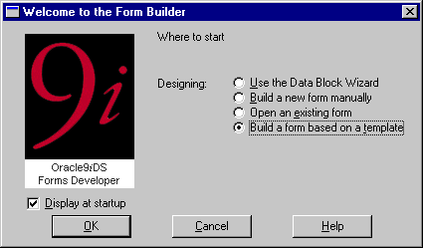

Template Forms
Notes:
Template Forms
You can create a new form based on standard template forms, so that you can provide other team members with a default starting point. Templates typically include generic objects, such as graphics, toolbars, and program units. You can define standard window layouts, standard toolbars, and other common objects that you want to include in new forms.
Creating a Form Based on a Template
To create a form based on a template, do one of the following:
Start Forms Builder. In the Welcome to the Forms Builder dialog box, select the “Build a form based on a template” option, and then click OK.
Select File > New > Form Using Template from the menu.

Slide 23
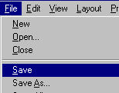

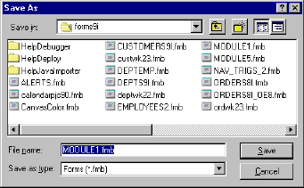
Saving a Form Module
To save the form module:
  Select File > Save
  OR
  Click the Save icon
  Enter a filename
  Navigate to
  desired location
  Click Save
Notes:
Saving a Form Module
To save the form module definition, perform one of the following:
Select File > Save
Select the Save icon
Both of these options display the File dialog box for the initial save. In the dialog box, do the following:
1. Enter a filename.
2. Navigate to the directory where you wish to save the file.
3. Click OK.
Note
When you save a form, a .fmb file is produced. This saved definition of a form in the file system is not executable, and can be opened only by Forms Builder.
When you work with more than one module at a time, Forms Builder separately keeps track of the changes that you make to each module. When you execute a Save command, only the current module is saved.

Slide 24

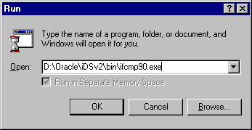


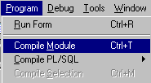
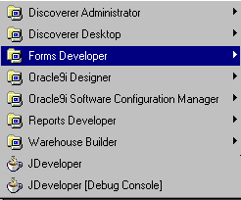
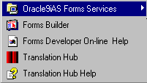
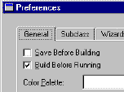
Compiling a Form Module
1
2
3
4
Notes:
Compiling a Form Module
Before you can run a form, you must compile an executable (.fmx) file from the design (.fmb) file that you created in the Forms Builder. Compiling a form (or menu) module creates the needed executable file.
Note: Compiling and saving are two independent tasks. Performing one does not automatically accomplish the other. Both tasks must occur separately.

Slide 25

Module Types and Storage Formats
Form
Module
.fmb
.fmx
.fmt
Menu
Module
.mmb
.mmx
.mmt
PL/SQL
Library
.pll
.plx
.pld
Object
Library
.olb
.olt
Notes:
Module Types and Storage Formats
When you create form modules, menu modules, and library documents in the Forms Builder, they are stored in source files (.fmb, .mmb, and .pll) that have a binary format and are portable across platforms. The executable application files (.fmx, .mmx, and .plx) are also in a binary format; however, they are not portable across platforms.

Slide 26
Notes:
Module Type and Storage Format (continued)
Note: .pll is portable but requires recompilation, because it contains both source and compiled pcode.

Slide 27




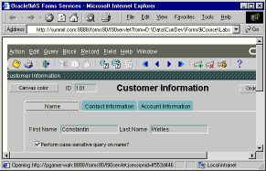
Deploying a Form Module
1
2
.fmb
.fmx
3
  1. Move module files to middle tier
  2. Generate module on middle tier
  3. Run in browser using
  9iAS Forms Services on middle tier
Notes:
Deploying a Form Module
Although you may test a form on your client machine, for production applications you usually deploy the module to a middle tier machine. This machine may be running on a different platform; if so, you need to recompile the module once you transfer it to the middle tier.
You can use an ftp utility to move the .fmb and other needed files to the middle tier machine, into a directory specified in FORMS90_PATH. If the platform is the same as your development platform, you can move the .fmx and other executable files there as well. If it is a different platform, you can invoke the Forms Compiler on the middle tier to recompile the module files.
Once the executables have been placed on the middle tier, you can invoke the application in a browser, using a URL that points to the Forms Servlet on the middle tier Web server.
Instructor Note
The standard classroom setup for this course does not include Oracle9i Application Server. You will perform demonstrations and students will complete practices by running forms on local machines using OC4J, installed as part of Oracle9i Developer Suite on each student and instructor machine.

Slide 28
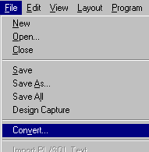
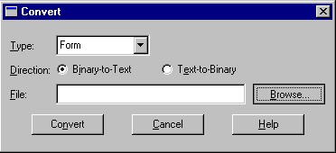
Text Files and Documentation
  Convert a binary file to a text file.
  Create an ASCII file for a form module.
Notes:
Producing Text Files and Documentation
The files normally produced by saving and generating modules are in binary format. To convert a binary file to text, perform the following:
1. Select File > Convert.
This opens the Convert dialog box.
2. Select the type of module (Form, Menu, PL/SQL Libraries, Object Libraries), the file to convert, and the direction (Binary-to-Text).
3. Select Convert. This produces a text file for the module with the name <module> .fmt.
To produce documentation for your module, perform the following:
1. Select the module to be documented in the Object Navigator.
2. Select File > Administration > Object List Report from the menu. This produces an ASCII file with the name <module> .txt.
You can also produce documentation in other ways not covered in this course:
Use Forms API to produce custom documentation of the module.
Convert the module to a .xml file with a separate utility included with Oracle9i Developer Suite.

Slide 29
Practice 4-1 Overview
This practice covers the following topics:
  Creating a new form module
  Creating a data block by using Forms Builder wizards
  Saving and running the form module
Notes:
Practice 4-1 Overview
The practice session for this lesson is divided into Part 1 and Part 2.
In Part 1, you will create one new form module. You will create a single-block form that displays a single record.
Create a new form module called CUSTOMERS. Create a new data block in this form by using the Forms Builder wizards, and base it on the CUSTOMERS table. Using the Layout Editor, reposition the items in this block to match the screenshot provided.
Save and run the new form module on the Web.
Note
For solutions to this practice, see Practice 4-1, in Appendix A, “Practice Solutions.”
Instructor Note
Advise the students not to spend too much time trying to get the layout of the CUSTOMERS block to exactly match the screenshot provided in Appendix A, because the layout for the items in this block will be modified in a later lesson.

Slide 30
Form Block Relationships
Master
Master
Master
Detail
Detail ↑
Master ↓
Detail
Detail
Detail
Notes:
Creating Data Blocks with Relationships
A form module can contain one or more data blocks. Each data block can stand alone or be related to another data block.
Master-Detail Relationship
A master-detail relationship is an association between two data blocks that reflects a primary-foreign key relationship between the database tables on which the two data blocks are based. The master data block is based on the table with the primary key, and the detail data block is based on the table with the foreign key. A master-detail relationship equates to the one-to-many relationship in the entity relationship diagram.
A detail block can be a master
You can create block relationships in which the detail of one master-detail link is the master for another link.

Slide 31
Form Block Relationships
Orders
Customers
Customers
Items
Orders
Orders
Account Rep
Items
Notes:
Creating Data Blocks with Relationships (continued)
A master block can have more details
You can create more than one detail block for a master block.
Note: The following are examples of the master-detail structure:
Master-detail: Order-items
Master-detail-detail: Customer-order-items
Master-2*detail: Customer-order and customer-account reps
Instructor Note
The Data Block Wizard also enables you to select an Oracle9i object when creating relationships.

Slide 32
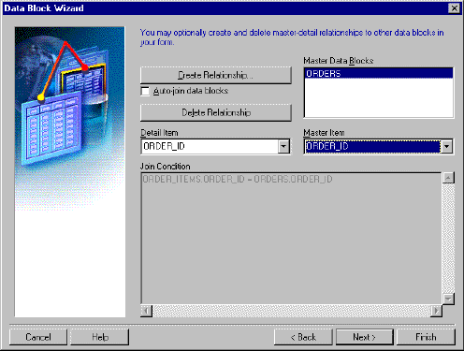
Data Block Wizard:
Master-Detail Page
Notes:
Creating a Master-Detail Form Module with the Data Block Wizard
You can build a master-detail form module either by creating a relation between a master and detail block explicitly, or implicitly by using the Data Block Wizard.
1. Create the master block as described earlier in this lesson in the topic Creating a New Data Block.
2. Invoke the Data Block Wizard in the Object Navigator.
3. Follow the same steps as before to create a new data block in the Data Block Wizard until you come to the Master-Detail page. On this page, select the “Auto-join data blocks” check box and click Create Relationship.
Note: If the “Auto-join data blocks” check box is clear, the Data Block dialog is displayed with a list of all data blocks in the form without any foreign key constraint names.

Slide 33
Notes:
Creating a Master-Detail Form Module with the Data Block Wizard (continued)
4. Select a master data block in the Data Block dialog and click OK. The wizard automatically creates the join condition between the detail and master data blocks in the Join Condition field and displays the name of the master data block in the Master Data Blocks field.
Note: If the “Auto-join data blocks” check box is clear, the wizard does not automatically create the join condition between the detail and master data blocks. You must use the Detail Item and Master Item pop-up lists to create a join condition manually.
5. Click Next; complete finish the Data Block Wizard steps. Go through the Layout Wizard steps as described earlier in this lesson to finish creating and laying out the detail data block.
Note: The master data block must exist in the form module before you create the detail block.
You can also create a relation by invoking the Data Block Wizard in reentrant mode.
Instructor Note
Demonstration
In the form you created for the earlier demo, create a second data block, using the Forms Builder wizards. Base the block on the EMPLOYEES table. In the Data Block Wizard, create a master-detail relationship between the new data block and the DEPARTMENTS data block.

Slide 34
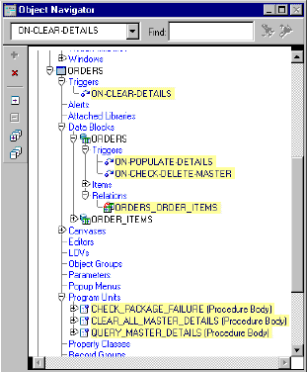
Relation Object
  New relation object created in Object Navigator under master data block node
  Default name assigned: MasterDataBlock_
  DetailDataBlock
  Triggers and program units generated automatically
Notes:
New Relation
Once you create a master-detail form module, the Data Block Wizard automatically creates a form object that handles the relationship between two associated data blocks. This object is called a relation. The following tasks occur automatically:
The new relation object is created under the master data block node in the Object Navigator with default properties.
The relation is given the following default name: MasterDataBlock_DetailDataBlock, for example CUSTOMERS_ORDERS.
Triggers and program units are generated to maintain coordination between the two data blocks.

Slide 35
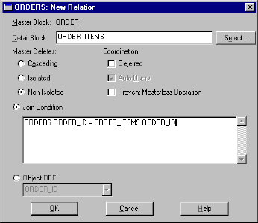
Creating a Relation Manually
Notes:
Creating a Relation Manually
You can create a relation either implicitly with the Data Block Wizard, or explicitly in the Object Navigator.
Explicit Relations
If a relation is not established when default blocks are created, you can create your own. To explicitly create a relation, perform the following steps:
1. Select the Relations node under the master block entry in the Object Navigator.
2. Click the Create icon. The New Relation window is displayed.
3. Specify the name of the detail block.
4. Choose your master delete property.
5. Choose your coordination property.
6. Specify the join condition.
7. Click OK.
The new relation, new triggers, and new program units are highlighted in the Object Navigator. Like implicitly created relations, the relation is given the default name of MasterDataBlock_DetailDataBlock, for example CUSTOMERS_ORDERS. The same PL/SQL program units and triggers are created automatically when you explicitly create a relation as when the relation is created implicitly.

Slide 36

Join Condition
  The join condition creates primary-foreign key link between blocks
  Define a join condition using:
    Block and item names (not table and column names)
    SQL equi-join syntax
Notes:
Join Condition
Use a join condition to:
Create links between blocks using SQL
Alter links between blocks using SQL
Define a join condition using:
Usual SQL equi-join condition syntax (necessary because Forms copies the value from the master block to the related item in the detail block)
Block names instead of the base table names
Item names that exist in the form module instead of base table column names
Instructor Note
Demonstration
In your DEPT_EMP demo form, delete the relation you created using the Data Block Wizard. Explicitly add a relation between the Department and Employee blocks. Set the deletion property to Cascading and the coordination property to Deferred with Auto-Query.

Slide 37
Deletion Properties
= Deleted
Isolated
Cascading
Nonisolated
No Detail Rec
Master-Detail
Records
Nonisolated
Detail Rec
Notes:
Deletion Properties
Master Deletes
You can prevent, propagate, or isolate deletion of a record in a master block when corresponding records exist in the detail block by setting the Delete Record Behavior property. For example, you can delete all corresponding line items when an order is deleted.
Note: Although deleting with the cascading property may remove many detail records, the commit message shows only the number of records deleted from the master block.

Slide 38
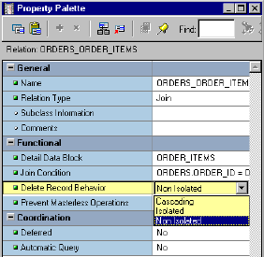
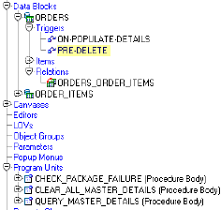
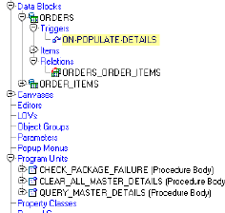
Modifying a Relation
Notes:
Modifying a Relation
You can alter the relation properties to affect the way deletes and block coordination are handled.
What happens when you modify a relation?
If you change the Delete Record Behavior property from the default of Non-Isolated to Cascading, the On-Check-Delete-Master trigger is replaced with the Pre-Delete trigger.
If you change the Delete Record Behavior property from the default of Non-Isolated to Isolated, the On-Check-Delete-Master trigger is removed.

Slide 39
Coordination Properties
Default
Deferred
with auto query
Deferred
without
auto query
Notes:
Coordination
Setting the coordination property controls how the detail records are displayed when a master block is queried. For example, you can defer querying the line items for an order until the operator navigates to the item block.
Note: In the New Relation dialog, setting the Deferred property to Yes enables the Auto Query check box.

Slide 40
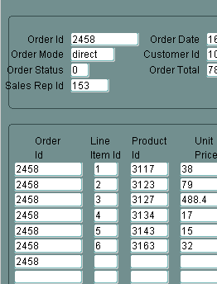
Running a Master-Detail Form Module
  Automatic block linking for:
    Querying
    Inserting
  Default deletion rules: Cannot delete master record if detail records exist
Notes:
Running a Master-Detail Form Module
When you run your master-detail form module you will find that:
Querying the master data block immediately retrieves corresponding detail records.
Deleting a master record is prevented if detail records exist.
Note: You can change the above behavior by modifying the relation object properties.
Inserting a detail record automatically associates it with the currently displayed master.

Slide 41
Summary
In this lesson, you should have learned that:
  To create a form module, you create an empty module, then add data blocks and other elements
  You can create a data block manually or with the Data Block Wizard and Layout Wizard
  You can modify a data block manually or with the Data Block Wizard in reentrant mode
  You can modify the layout manually or with the Layout Wizard in reentrant mode
  You can save and compile a form module using the File and Program menus or from the toolbar
Notes:
Summary
This lesson presented information about:
Building a new form module by using the following methods:
Forms Builder wizards
Manually
Template form
Using the Data Block Wizard to create a new data block with its associated data sources quickly and easily
Using the Layout Wizard to quickly lay out the new data block contents for user interaction
Modifying the data block layout:
Using reentrant wizards
Changing frame properties
Saving the form module to preserve its definition; compiling it to get an executable file; running the form module to test it

Slide 42
Summary
  You can store form, menu, and library modules in text format, in a portable binary format, or a
  non-portable binary executable format
  To deploy a form module, you move it to the application server machine and generate it
  You can create data blocks with relationships by using the Data Block Wizard or by manually creating a Relation object
  When you run a master-detail form, block coordination is automatic depending on properties of the Relation object
Notes:
Summary (continued)
Using several module types and storage formats that are available for form modules, menu modules, PL/SQL Library documents, and Object Library modules
Creating data blocks with a master-detail relationship

Slide 43
Practice 4-2 Overview
This practice covers the following topics:
  Creating a master-detail form module
  Modifying data block layout by using the Layout Wizard in reentrant mode
  Saving and running the form module
Notes:
Practice 4-2 Overview
In the Part 2 practice, you will create a new form module that displays master-detail information.
Create a master-detail form module called ORDERS. Create a master block based on the ORDERS table and a detail block based on the ITEMS table. Create a third data block that is not related to any other block in the form module. Base this block on the INVENTORIES table, and manually create a relation with the block based on the item table. Use the Forms Builder wizards to create all three data blocks.
Invoke the Layout Wizard in reentrant mode, and change the layout of the ITEMS and INVENTORIES data blocks.
Save and run the new form module on the Web.
Note
For solutions to this practice, see Practice 4-2, in Appendix A, “Practice Solutions.”

Slide 44
Notes:
Practice 4-1
1. Create a new form module.
Create a new single block by using the Data Block Wizard.
Base it on the CUSTOMERS table and include all columns.
Display the CUSTOMERS block on a new content canvas called CV_CUSTOMER and show just one record at a time. Set the frame title to Customers. Set column names and widths as shown in the following table:
2. Save the new module to a file called CUSTGXX, where XX is the group number that your instructor has assigned to you.
3. Run your form module and execute a query.
Navigate through the fields. Exit the run-time session and return to Forms Builder.
4. Change the form module name in the Object Navigator to CUSTOMERS.
5. In the Layout Editor, reposition the items and edit item prompts so that the canvas resembles the following:
Hint: First resize the canvas and the frame.

Slide 45
Notes:
Practice 4-1 (continued)
6. Save and compile the form module.
Click Run Form to run the form. Execute a query.

Slide 46
Notes:
Practice 4-2
1. Create a new form module.
Create a new block by using the Data Block Wizard.
Base it on the ORDERS table and include all columns except ORDER_TOTAL and PROMOTION_ID.
Display the ORDERS block on a new content canvas called CV_ORDER and show just one record at a time. Use a form style layout. Set the frame title to Orders.
2. Create a new block by using the Data Block Wizard.
Base the block on the ORDER_ITEMS table and include all columns.
Create a relationship and select the master block as ORDERS.
Display all items except ORDER_ID on the CV_ORDER canvas.
Display six records in this detail block on the same canvas as the master block.
Use a tabular style layout and include a scroll bar.
Change the order of the blocks in the Object Navigator, moving the ORDER_ITEMS block after the ORDERS block. Set the frame title to Items.
3. Save the new module to a file called ORDGXX, where XX is the group number that your instructor has assigned to you.
4. Create a new block based on INVENTORIES (do not create any relationships with other blocks at this time) to display on a different canvas.
Base it on the INVENTORIES table.
Display four records in this block and ensure that they are displayed on a new content canvas called CV_INVENTORY.
Use a tabular style layout, and include a scroll bar.
In the Object Navigator, move the INVENTORIES block after the ORDER_ITEMS block. Set the frame title to Stock.
Do not create any relationships between blocks at this stage.
5. Create a relation called Order_Items_Inventories explicitly between the ORDER_ITEMS and INVENTORIES blocks.
Ensure that line item records can be deleted independently of any related inventory.
Set the coordination so that the Inventories block is not queried until you explicitly execute a query.
6. On the ORDER_ITEMS block, change the prompt for the Line Item ID item to Item# by using the reentrant Layout Wizard. First select the relevant frame in the Layout Editor, and then use the Layout Wizard.
7. In the INVENTORIES data block, change the prompt for Quantity on Hand to In Stock by using the Layout Wizard.
8. Save and compile your form module.
Click Run Form to run your form.
Execute a query.
Navigate through the blocks so that you see the INVENTORIES block.
Exit the run-time session, close the browser, and return to Forms Builder.
9. Change the form module name in the Object Navigator to ORDERS and save.

